Slide 1
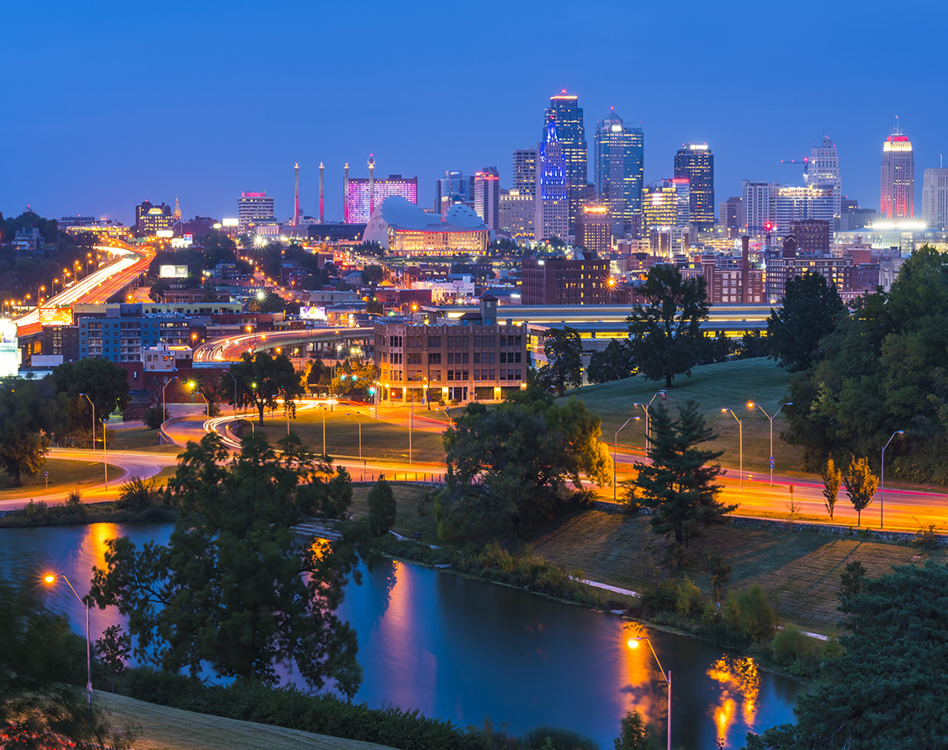
Kansas City, MO: Crime vs COVID
Project 2: AnnMarie Morrison, Mercy Griffin, Taniya Chhabra, and Areej Humaydan

